Slide 1

Healthcare Administration
Data Warehouse
CS 779: Term Project
Vaidehi Shah

Slide 2
INTRODUCTION
This project aims to develop a tailored data warehousing solution for Hospital Administration, enabling data-driven decision-making, streamlined processes, and enhanced efficiency. Implementing a tailored data warehousing solution empowers the Hospital Administration with a centralized platform for efficient data access, analysis, and interpretation. It enhances patient care, financial operations, and resource allocation.
The Hospital Administration has several key areas requiring comprehensive reporting and analysis:
1.Patient Data: By leveraging the data warehousing solution, the Hospital Administration gains access to a comprehensive patient database that enables a deeper understanding of patient demographics and medical history.
2.Financial Operations Optimization: This analysis aids in identifying potential areas for improvement, streamlining financial operations, and optimizing revenue generation.
3.Resource Allocation & Planning: By analyzing various operational metrics, such as patient flow and healthcare provider performance, the administration can make informed decisions regarding staffing, equipment, and facility utilization, leading to optimized resource allocation and planning.

Slide 3
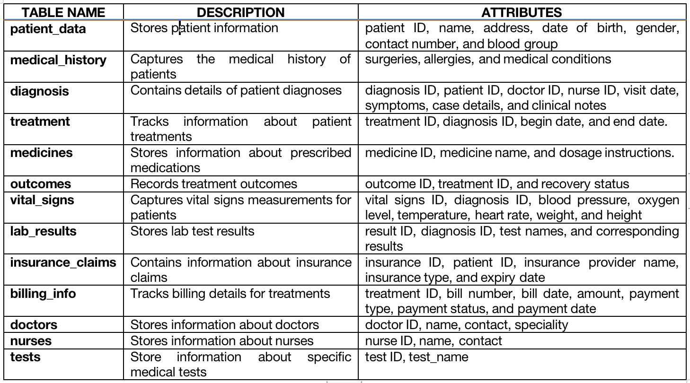
DESIGNING HOSPITAL ADMINISTRATION SCHEMA

Slide 4
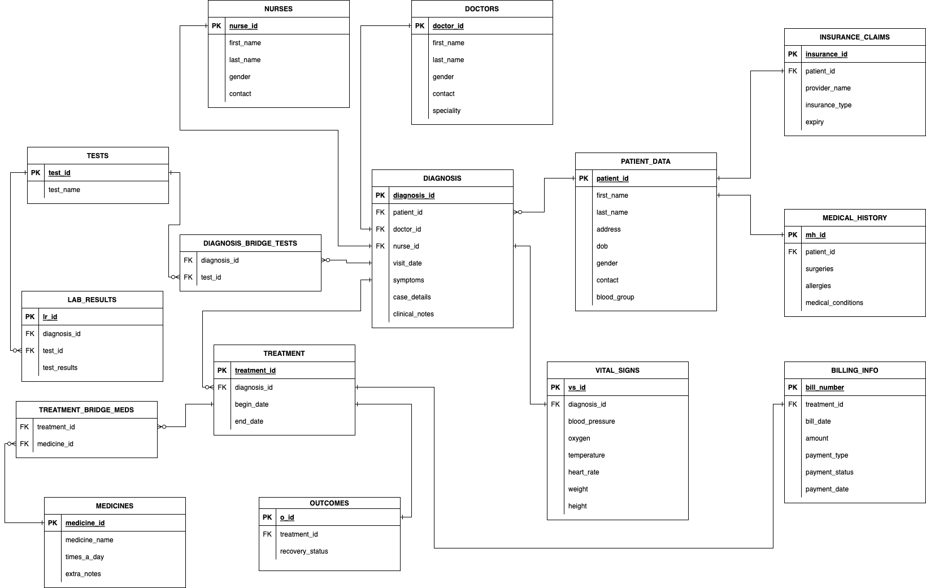
ENTITY-RELATION DIAGRAM

Slide 5
DATA GENERATION & DATABASE CREATION
Here is a comprehensive overview of the implemented Python code which utilizes loops and conditional statements to ensure the desired volume and characteristics of the data to be generated for the database.
The code leverages various libraries, including
Faker: Used for generating fake data, such as names, addresses, and other relevant information.
csv: Employed for handling CSV files, facilitating efficient data manipulation and storage.
random: Utilized to generate random numbers, enabling diverse data distribution.
pandas: Employed for creating DataFrames, a convenient data structure, and for exporting data to Excel.
This section outlines the approach employed to generate data, organize it into multiple tables in CSV format, and subsequently import the tables into a database using create table and insert value queries.
I have worked on PostgreSQL on pgAdmin Tool for this project. To import the generated data into a database, I used the create table and insert value queries in SQL. The create table query facilitates the creation of appropriate tables within the database including the constraints, and the insert value query allows for the population of these tables with the generated data. By executing these queries, the data is seamlessly imported into the database, ready for further analysis and utilization.

Slide 6
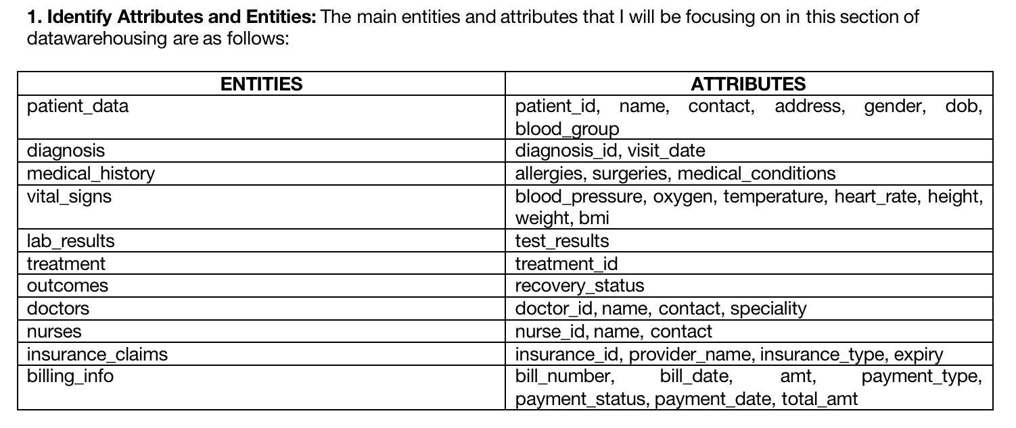
DATA MODELING

Slide 7
DATA MODELING
2.Dimension & Fact Tables: Dimension tables and fact tables are important aspect of a data warehouse.
Dimension Tables: Dimension tables contain descriptive attributes that provide context and details about the data in a data warehouse. The tables in my data warehouse that are classified as dimension tables are: patient_data, medical_history, tests, doctors, nurses, diagnosis, outcomes.
Fact Tables: Fact tables contain the quantitative and measurable data that are the focus of analysis in a data warehouse. The tables in my data warehouse that are classified as fact tables are: treatment, vital_signs, lab_results, insurance_claims, billing_info.

Slide 8
DATA MODELING
3.Snowflake Dimensional Model: Based on my data modeling for the data warehouse, Snowflake Schema is the appropriate choice. In a snowflake schema, the dimension tables are structured hierarchically, with each level of the hierarchy represented by a separate table. This normalization process reduces data redundancy by removing repeating groups of attributes. The normalized tables are connected through foreign key relationships, creating a "snowflake" shape when viewed visually. It involves certain important dimension tables (diagnosis, patient_data, treatment) which are in turn connected to several other tables (medical_history, vital_signs, outcomes, doctors, nurses, etc.) to extract information.
Pros of Snowflake Schema:
Improved Data Integrity: Normalization reduces data redundancy, leading to improved data consistency and integrity.
Space Efficiency: By eliminating duplicate data, the snowflake schema can save storage space.
Flexibility: The hierarchical structure of the dimension tables allows for more complex relationships and accommodates additional attributes.
Scalability: Snowflake schemas are well-suited for large-scale data warehouses that require efficient storage and support for complex queries.
Cons of Snowflake Schema:
Increased Complexity: The normalized structure of the snowflake schema requires more joins to retrieve data, which can lead to increased query complexity and potential performance overhead.
Query Performance: Due to the additional joins involved, queries on a snowflake schema may take longer to execute compared to a star schema, especially for complex queries spanning multiple tables.
Maintenance Overhead: The increased number of tables and joins in a snowflake schema can make it more challenging to maintain and update the database.

Slide 9
DATA MODELING
4.SCDs (Slowly Changing Dimensions):
Type-1: In a Type 1 SCD, when a change occurs in a dimension attribute, the existing record is simply updated with the new value, overwriting the old value. This means the historical values are lost, and the dimension only reflects the latest state of the attribute.
Type-2: In a Type 2 SCD, when a change occurs, a new record is added to the dimension table to represent the updated attribute value. This way, historical versions of the data are preserved, and the dimension table maintains a history of changes over time.
Type-3: In a Type 3 SCD, only a limited set of historical attribute values are stored in the dimension table. Usually, two columns are added to represent the current value and a previous value.

Slide 10
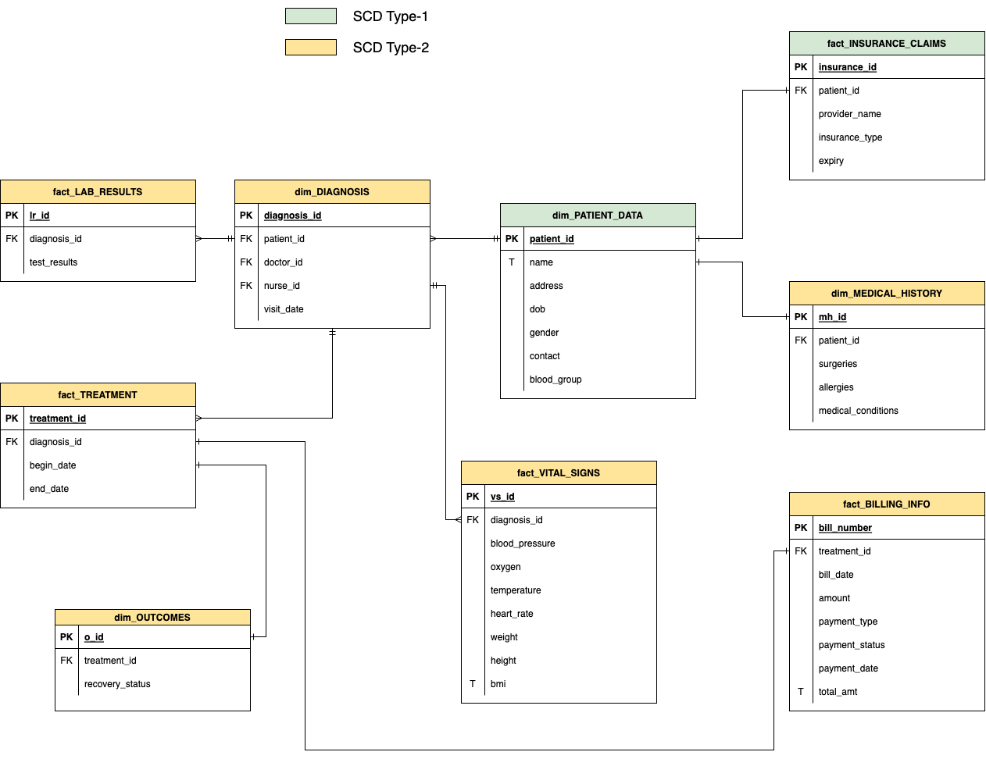
DATA MODELING

Slide 11
ELT (Extract Load Transform)
In ELT, data is first extracted from various sources, then loaded into a target data storage system (such as a data warehouse or data lake), and finally transformed within the target system itself using its native processing capabilities, such as SQL queries, stored procedures, or distributed computing frameworks. The key difference between ELT and ETL lies in the location where data transformation occurs.
Advantages of ELT:
Scalability: ELT leverages the power and scalability of the target system, allowing it to process large volumes of data efficiently.
Flexibility: With ELT, data can be transformed and analyzed in various ways based on the specific needs of different users or applications. Users have access to raw data and can perform transformations as per their requirements.
Cost-effectiveness: ELT reduces the need for dedicated transformation servers or systems, which can lower infrastructure and maintenance costs.
Real-time insights: Since data is loaded first and transformations occur within the target system, ELT can enable near real-time analytics and reporting.
Disadvantages of ELT:
Data quality and governance: With ELT, data quality and governance practices must be implemented within the target system itself, as data transformation happens there. This requires careful planning and management to ensure consistent data quality and compliance.
Performance impact: Depending on the target system and the complexity of transformations, ELT processes may put a higher load on the system, impacting overall performance. System optimization and tuning might be necessary to mitigate any performance issues.

Slide 12
CONCLUSION
In conclusion, the implementation of a tailored data warehousing solution for Hospital Administration is essential for achieving data-driven decision-making, streamlined processes, and enhanced efficiency.
The solution provides a comprehensive patient database, enabling valuable insights into patient demographics and medical history. It also facilitates financial efficiency by identifying improvement areas and streamlining processes for financial stability. Moreover, by analyzing operational metrics such as patient flow and healthcare provider performance, the administration can make informed decisions on staffing, equipment utilization, and facility planning.
Overall, this tailored data warehousing solution empowers the Hospital Administration to leverage data strategically, resulting in improved patient care, optimized financial operations, and enhanced resource allocation and planning. Embracing this solution drives positive changes, optimizes processes, and ensures the delivery of high-quality healthcare services while achieving operational excellence.

